Slide 1
APPLIANCE 101
Clayton Gomi
SERVCO Home & Appliance Distribution

Slide 3
Internet consumer reports
Friends
Service People
DO YOUR RESEARCH!!

Slide 4
Consideration Of Selections
Types of Appliances
Refrigeration
Cooking
Ventilation
MIcrowaves
Dishwashers
Recap/Questions

Slide 5
Appliance 101
“WE CAN CUT WOOD,
BUT WE CAN’T CUT METAL”

Slide 6
Considerations in Selecting
Your NEW Appliances
SPACE
FUNCTION
COST
APPLICATION

Slide 7
Will it fit/work in my kitchen design?
Is it something that I will be using?
Is it in my budget?

Slide 8
REFRIGERATION
Built-In
Custom/Cabinet Depth
Freestanding/Full Size

Slide 9


Types Of Refrigerators
Side By Side
Bottom Freezer

Slide 10


Types Of Refrigerators
French door /3 door
Top Freezer

Slide 11

Built In Refrigeration
Features:
Least capacity for size
Most expensive
Size – 18” -36” in width with heights of 80” – 84”
Very Shallow ( SxS, Bottom Freezer, French door, Single)
Unfinished sides
Attached to cabinets or walls
True integrated /panel look

Slide 12
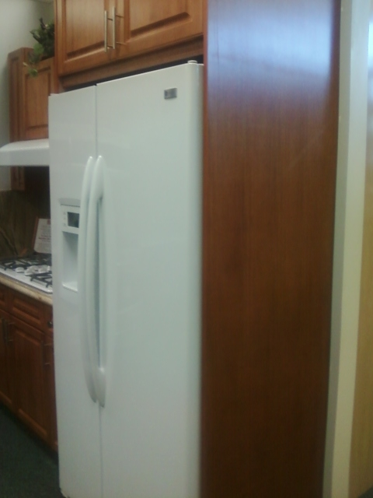
Cabinet/Counter Depth
Features:
“Pay more for Less”
Most expensive in FS Platform
Typically 36” by 70”-72”
Limited selections (SxS, Bottom Freezer, French door)
Inexpensive Built in appearance
Typically for smaller kitchens
Custom panel option

Slide 13
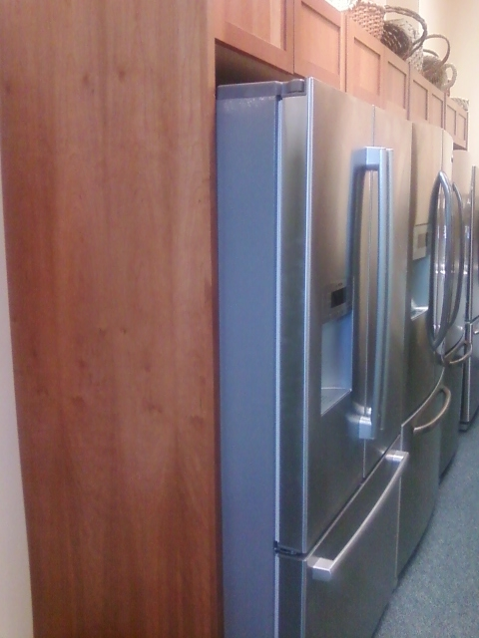
Freestanding/Full size
Features:
“Pay less for More”
Least expensive of FS Platform
Widths start at about 24” – 36” and height from 47” -72”
Variety of styles(SxS, Bottom Freezer, French door, Top Freezer)
Achieve custom depth with custom cabinet panels
Always ask for 36” box

Slide 14
Cooking
Ranges
Cook Tops
Professional Cook /Range Tops
Gas Cook Tops
Electric Cook Tops
Induction Cook Tops
Professional Range
Slide in Range
Drop in Range
Freestanding Range
Ovens
Professional Wall Ovens
Electric Wall Ovens
Gas Wall Ovens

Slide 15
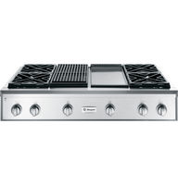

Pro Cook Tops
Most Expensive
Widths of 36” – 54”
Controls on front panel
All Burners are same BTU’s(Natural or LP)
Optional Grill and Griddle
Typically up to 6 burners on a 36” and 6 burners and an optional Grill or Griddle on a 48”

Slide 16
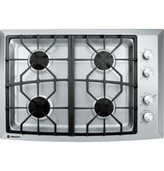
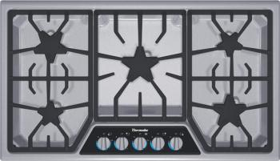
Gas Cook Tops
Reasonably Priced
Typical widths or 30” or 36”
Controls are on the unit
Burners will have varying Strengths
Normally 4 burners on a 30” and 5 burners on a 36”, Bosch /Thermador has a 30” 5 burner
Installation is into counter top

Slide 17

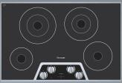
Electric Cook Tops
Very Reasonably Priced
Sizes will vary from 21” – 36” wide
Controls are on unit in either a Knob or Touch controls
Burners will have varying wattages
30” tops have 4 burners and the 36” top has 5 burners
Installation is directly into counter top

Slide 18


Induction Cook Tops
Highest Priced
Sizes will be in widths of 30” and 36”
Controls are touch only
Colors are Black or Mirror/metallic finishes
Installation is directly into countertop
Caution- Electrical requirements will vary by Manufacturer

Slide 19
Ovens – Basic Facts
Thermal Ovens (Electric)
  Least Expensive
  Bake element on bottom, Broil element on Top
  Standard Clean or Self Clean
Regular/American Convection
  Middle of the road pricing
  Bake and Broil Element as well as a fan on the back wall to circulate air
  Typically only Self Clean
True /European Convection
  Most Expensive
  Bake and Broil Element as well as a fan on the back wall that will have a THIRD Element around the fan
  Only Self Clean

Slide 20
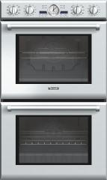

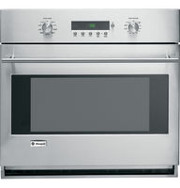
Pro Ovens
Like with any Professional appliances, these are the most expensive in this category
Sizes will be 27” or 30” wide
Controls are almost always Knobs, Chefs choice
Stainless Steel Only
Thermal or Convection
Caution – Electrical requirements will vary

Slide 21


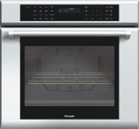
Electric Ovens
Moderately priced , depending on Options
Size 27” or 30” widths
Controls – Touch or Knobs
Color SS, Black , White and Clean Steel
Thermal, Convection or True Convection
Standard Clean or Self Clean
Racks, Bake element,(Hidden or not) ,Other Options, Meat probe, Rotisserie and even Steam!!

Slide 22
Ranges
Professional Ranges
Slide in Ranges
Drop in Ranges
Free Standing Ranges

Slide 23
Range - Basic
All Gas
  Will come in Natural Gas or can be converted to Liquid Propane(LP)
All Electric
  Will require purchase of a power cord, either 3 prong or four prong
Dual Fuel
  Gas Cooking Surface with an electric oven(True Convection)
Induction
  Will have a Electric Oven(True Convection)

Slide 24
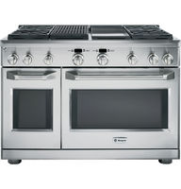
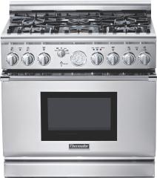
Pro Ranges
Most Expensive
Size will start at 30” – 48”
BIG, BOLD & STAINLESS
All Gas or Dual Fuel, Natural or LP
Cooking surface is always Gas, with all burners having same power
36” up to 6 burners(options), with 48” having up to 6 burners as well with options
Ovens are either gas or electric, Thermal (typically the second oven)or True convection

Slide 25

Slide – In Range
Features:
Highest priced , depending on Options
Size - 30” widths
Knob Controls for Surface top and touch controls for oven are on the front
Color SS, Black , White and Clean Steel
Thermal, Convection or True Convection
Standard Clean or Self Clean
Racks, Bake element,(Hidden or not), Other Options, Meat probe, Rotisserie and even Steam!!
Clean look, will sit on counter top
ADA approved
Installation will require to cut counter top, will require a power cord
Unit will actually stand on floor as well

Slide 26

Drop in Ranges
Features:
Similar in cost to Slide In, Few options
27” or 30” widths
Knob Controls for Surface top and touch controls for oven are on the front
Color SS, Black and White
Thermal or True Convection
Standard Clean or Self Clean
Unit will sit on Cabinets, most costly installation
ADA Approved

Slide 27

Free Standing Ranges
Features:
Least expensive of the Range options and more options
Sizes are 20”, 24” and 30” widths
Knob Controls for Surface top and touch controls for oven are on the back panel , Gas tops will have controls on front
Color SS, Black Bisque, Clean Steel and White
Thermal , Convection or True Convection
Standard Clean or Self Clean
Induction, Gas, Dual Fuel, Electric
Installation, easiest and cheapest to install, will require a power cord
Racks, Bake element, (Hidden or not), Other Options, Meat probe

Slide 28
Ventilation
Professional Hood
  Most effective type
Chimney/Wall /Designer Hood
  Accounts for the most sales
Island Hood
  Limited applications and styles
Under Cabinet Hood
  Most economical
OTR – Over the Range Microwave Vent
  Very common Application
Down Drafts
  Least effective of venting systems

Slide 29
Ventilation
The basic need for ventilation is simple, CLEAN AIR!!!
Proper ventilation is important for the health and well being of the people in the house as well as your house itself.
Proper Ventilation will clean your air of Smoke, Odors, Grease and Moisture. None of which is any good for your health.
Majority of Sales is based on Style and Design

Slide 30
Ventilation – Basic
Proper ventilation requires the hood to have the correct CFM’s for the cooking surface and maximum capture area
Basic Calculator:
  Electric top 10 CFM/Inch ,
  Gas Total BTU’s/100
I always recommend as high a CFM blower as possible
Loudest appliance in the kitchen ,three types of Blowers
Internal Blower – Attached directly to Hood, Ability to recirculate, Limited size
In-line Blower – Along the Ducting, Need attic or crawl space
Exterior Blower – On outside of home, Maximum Size, quietest

Slide 31
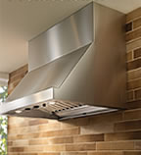
Pro Hoods
Features:
Highest priced
30” to 54” in width and 24” to 27” in depth
Controls can be remotely mounted or on unit
Stainless or Stainless
Almost always a remote blower, inline or Exterior
Usually greatest capture area

Slide 32
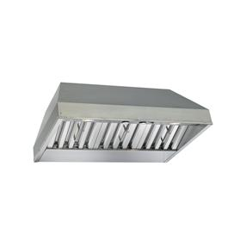
Built In Ventilation
Featrures:
Less expensive than Pro
It is not finished so you will need to order cabinet panels
Controls , Like pro remote or on unit
Blower options, Internal, In-Line or Exterior
Very good capture area

Slide 33
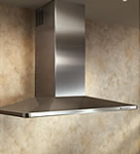
Chimney/Wall/Designer Hood
Features:
Price is determined by design and style
Sizes will vary from 30” to 48” in width,
Controls , depending on hood is usually on unit, higher end models can be done remotely
Blower options, all

Slide 34
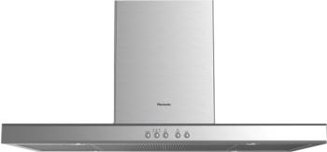
Island Hood
Features:
Price is determined by design and style
Sizes will vary from 30” to 48” in width,
Controls , depending on hood is usually on unit, higher end models can be done remotely
Blower options, all

Slide 35

Under Cabinet Hood
Features:
Typically the least expensive
Sizes will vary from 30” to 48” in width,
Controls , depending on hood is usually on unit, higher end models can be done remotely
Blower options, all

Slide 36

OTR – Over The Range
Features:
Inexpensive for Dual purpose
Size is 30” with one 36” option
Blower size will vary form Manufacturer , but usually around 280 CFM
Different types for different needs
Recirculating option , very common

Slide 37

Down Draft Ventilation
Features:
Price is on higher side
Size 30” or 36”
Island application
Blower options, all
Thermador and Bosch have recirculating option
Most intricate to install because we need to cut countertop.
Least effective

Slide 38
Microwaves
Determining factors for Microwaves :
Wattage
Capacity
Cooking Options:
Convection
Broiler
Application Options:
Counter top
Built In
OTR

Slide 39


Microwaves
Built In
Counter top

Slide 40
Dishwashers
Technology in Dishwashers have probably made the biggest
improvements in all of the appliance world within the last
decade or so.
They used to be the loudest, now they are probably the quietest Appliance in the kitchen.
They are very energy efficient and use very little water. The
Bosch units will use less than 3 gallons of water for a full load.
Two types of Dishwashers:
  American style - Heating element, food grinder
  European Style – Internal water heater, Condensation
  drying.

Slide 41

Dishwasher
Higher cost
Size 18” and 24” widths
Hidden controls
Higher end models :
  Quieter
  More cycles
  More water efficient
Tubs
  Stainless or Plastic

Slide 42

Dishwasher
Most cost efficient
Size 18” and 24” widths
Controls on front
Higher end models :
  Quieter
  More cycles
  More water efficient
Tubs
  Stainless or Plastic

